Slide 1
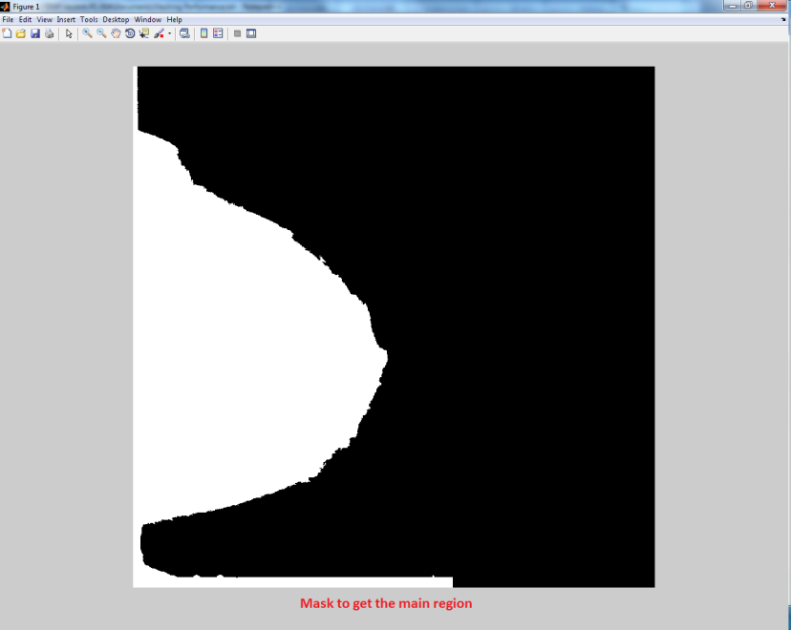
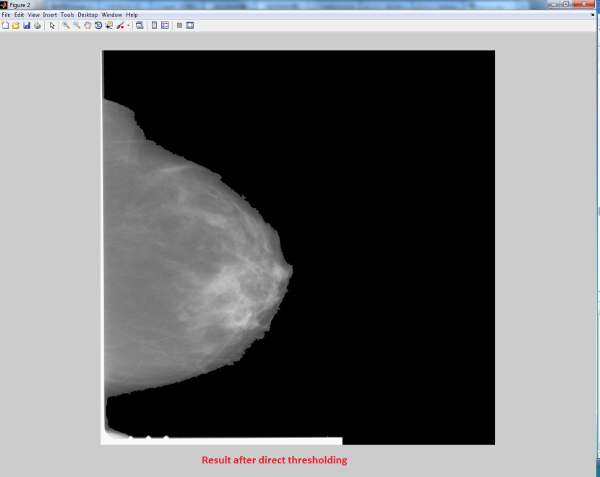
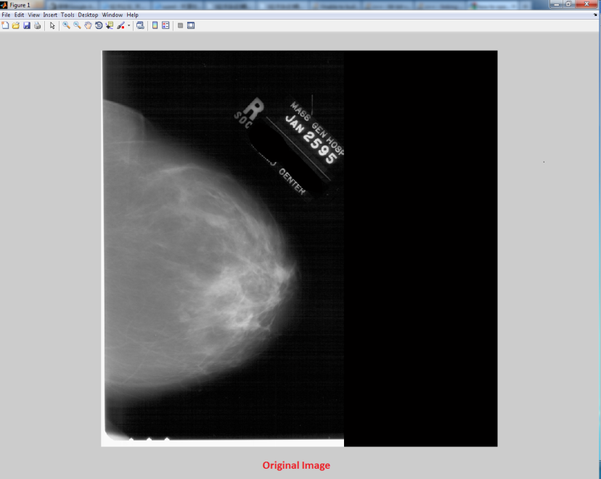
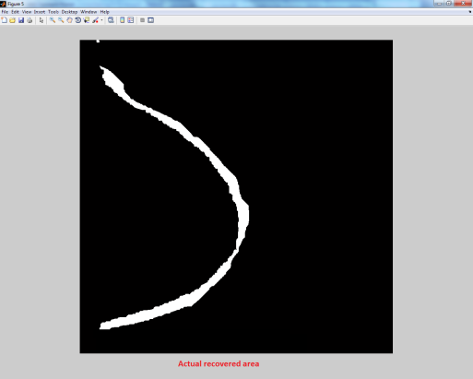
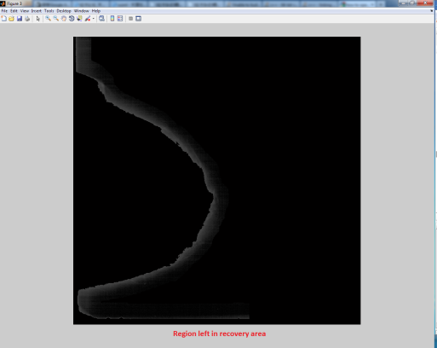
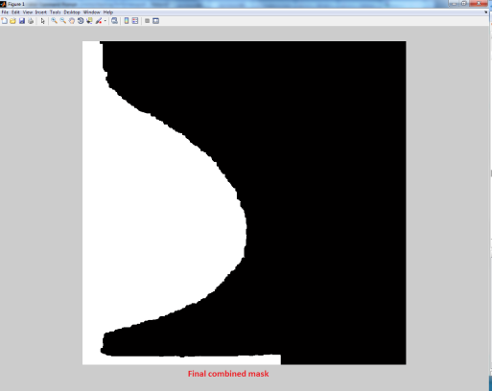
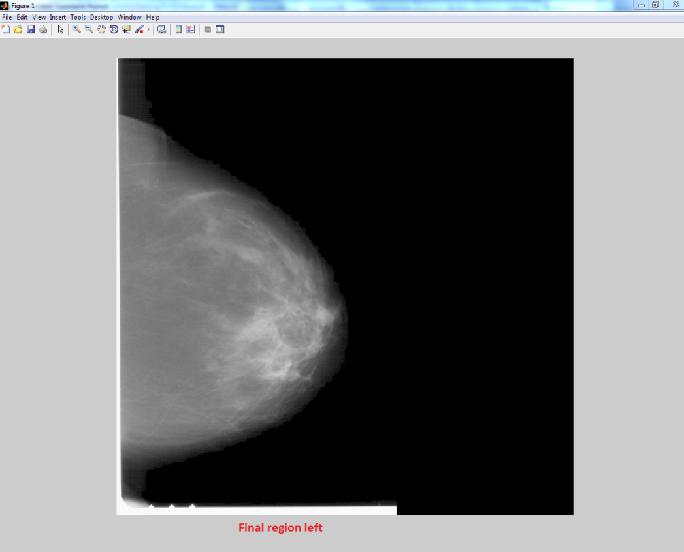
Comparison between global based global threshold and thresholding Plus boundary recovery
Segmentation Mask from
Thresholding algorithm only
Background is cleaned up however part of boundary of breast is gone
some important Information May be lost there
Original Image
Enlarged area at the border of original
Mask to recover breast border
Border Area to perform recovery on
Dilated mask
Segmented image after border recovery
has a much better breast boundary

