Slide 1

RSCHS
50
Welcome Class of ‘75
T-Birds
Forever!

Slide 2

It is so wonderful having your school friends still in your life. Those bonds are truly rare and such priceless gifts.

Slide 3
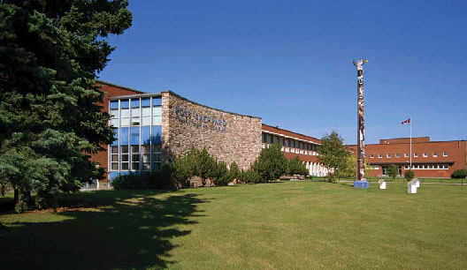
Shep in the 70s

Slide 4
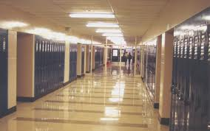
2nd floor hallway

Slide 5
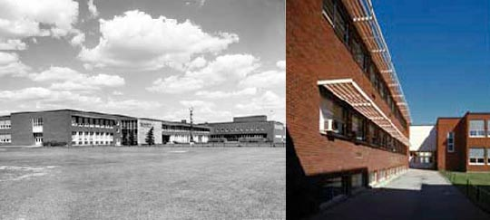

Slide 6
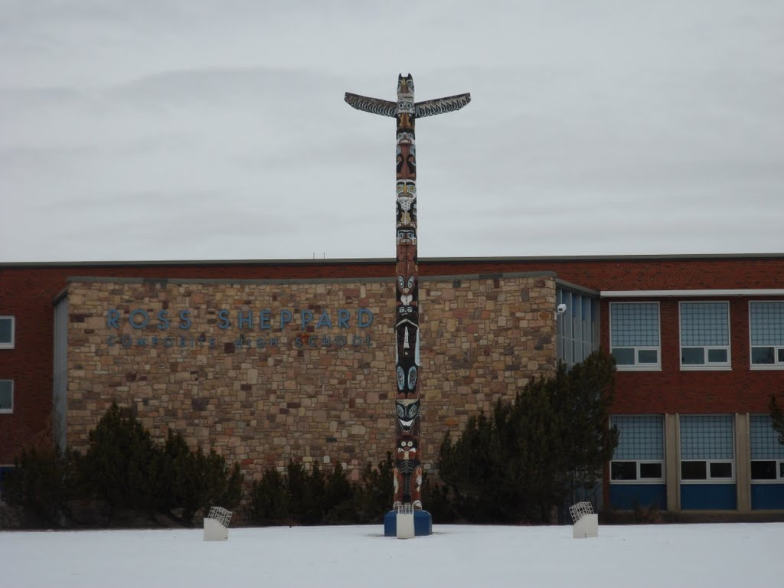

Slide 7
The official opening was held on October 22, 1958, but the 16-classroom wing on the west side was still to be completed.
In October 1967, a totem pole, carved by Charles Dudoward of Port Simpson, B.C., as a centennial project, was raised on the school grounds.
Dudoward, last hereditary chief of the Tsimshian did the carving in the gym of Ross Sheppard High School.

Slide 8

Mascot | Earl Bird
Team name | Thunderbirds/T-Birds
Colours | Navy Blue, Columbia Blue, and White
Founded | 1957
Enrollment | ~2500

Slide 9
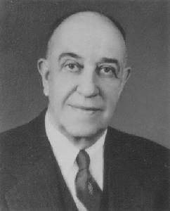
The school's namesake
Sheppard represented Canada in the 1924 Olympic Games in Paris, and competed in the hop, step and jump. Sheppard went on to become a teacher, principal and school administrator, and served as superintendent of the Edmonton Public School Board from 1940 to 1955. When he retired, the school board named its newest high school in his honour, constructed starting in 1956, and then added onto in 1958.
Sheppard devised the composite high school system, becoming the first superintendent in Canada to implement the concept. During his 15 years as Superintendent of Schools, the number of permanent public schools increased from 30 to 63.

Slide 10
Ross Sheppard School's philosophy is based on four pillars - Academics, Arts, Athletics and Service
…in our era!

Slide 11
Notable Alumni
Murray Campbell – creator of Deep Blue that defeated world chess champion Garry Kasparov in 1997
Jermaine Bucknor – basketball player
Meghan Collison – high fashion model
Paul Comrie – NHL
Jessica Greg - Olympic Short Track Speed Skater (2010) Silver Medalist
Wayne Gretzky – aka “the great one”
Barb Higgens – newscaster and journalist CTV
Susan Humpheys - Olympic Figure Skater
Rick LeLachuer - President & CEO Edmonton Eskimos
Hugh O’Neill – CFL player
Annamay Pierse - Olympic Swimmer , World short course Record Holder
Jame Sale - Olympic Figure Skater & Olympic Gold Medalist
Paula Simons – Edmonton Journal
Adam Thrasher – creator of Space Moose
Marc Talbert – CFL player and Grey Cup winner Edmonton Eskimos
Angela Whyte – Olympic track & Field 2004, 2008

Slide 12
The Early Years
 | "As the years go by, we will remember our friends by the moments of happiness we shared..."
T- Birds Forever!

Slide 13


Slide 14
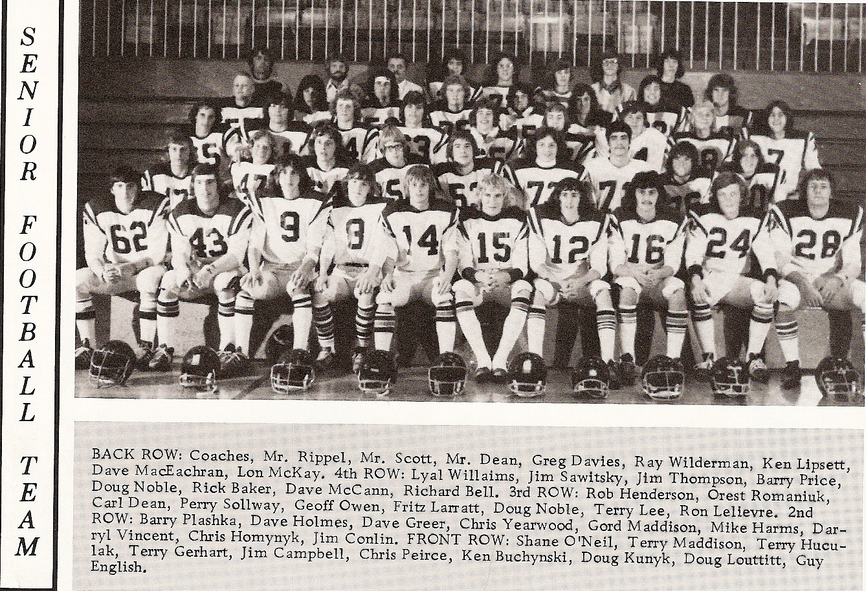

Slide 16
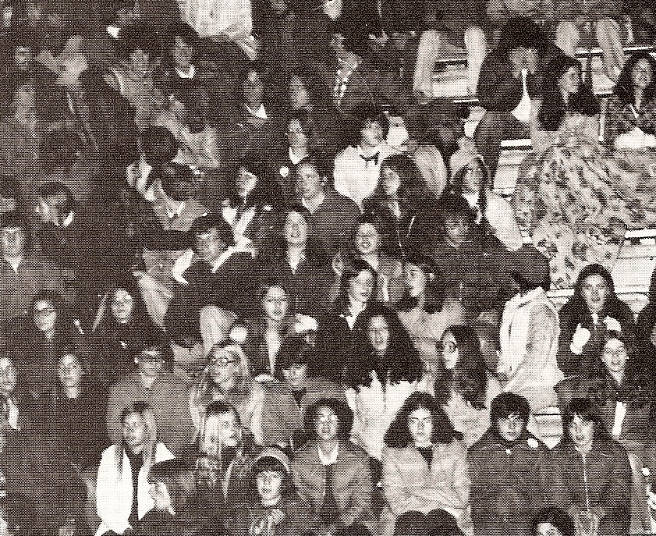

Slide 17
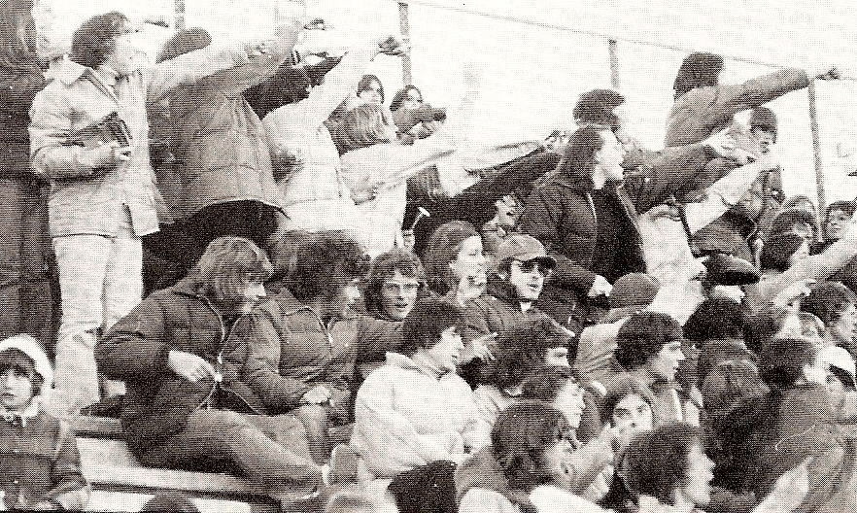
Go that way!

Slide 18
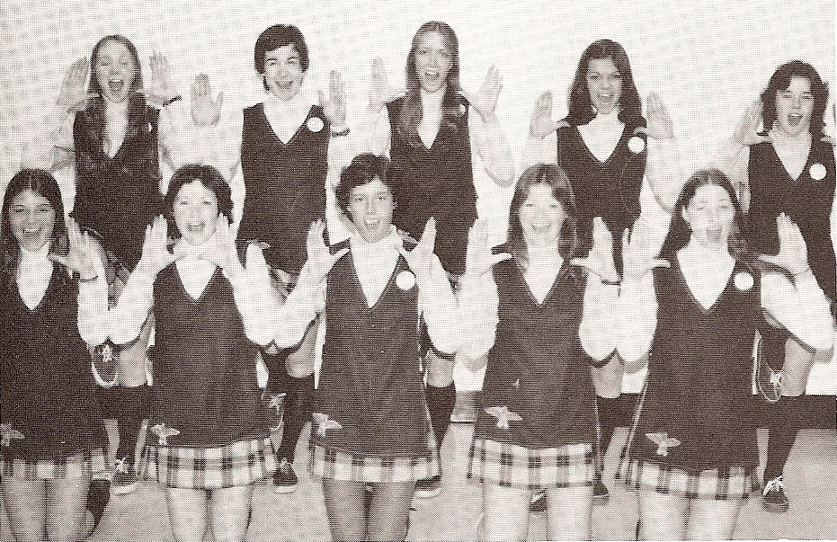

Slide 19
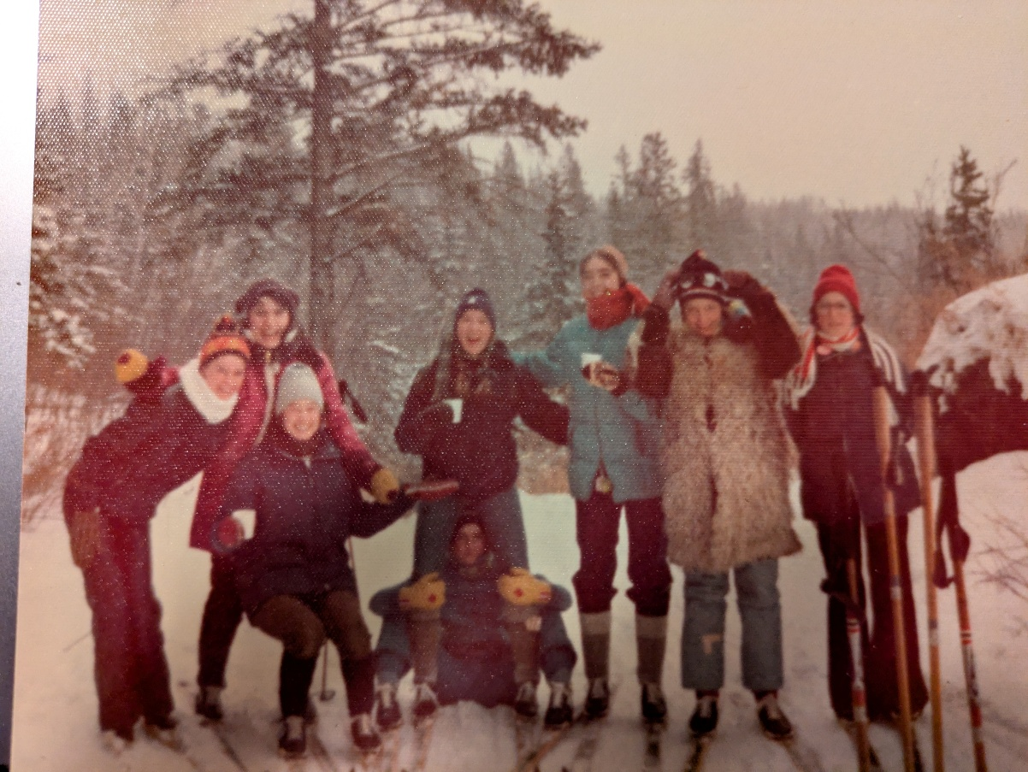
Phys Ed 30L Girls Ski Day
What was in those cups? Sure was tasty!

Slide 20
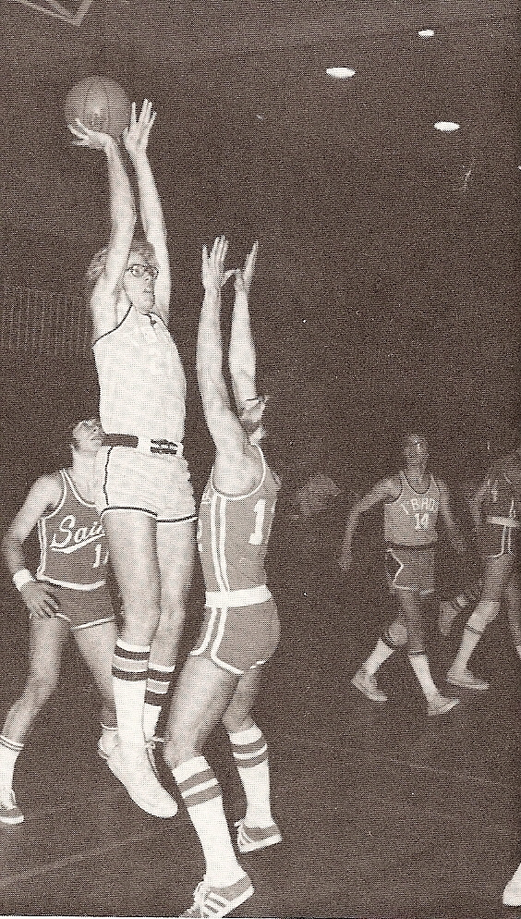
Wish I could jump that high

Slide 21
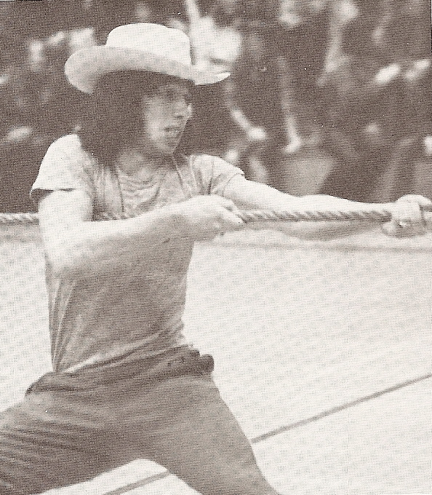
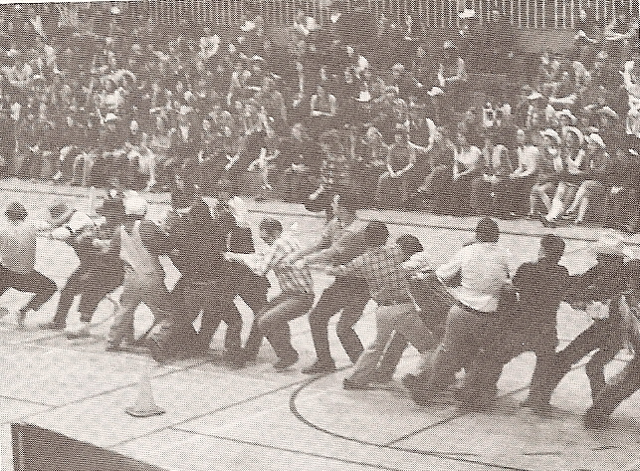
Western Days
That guy sure is strong!

Slide 22
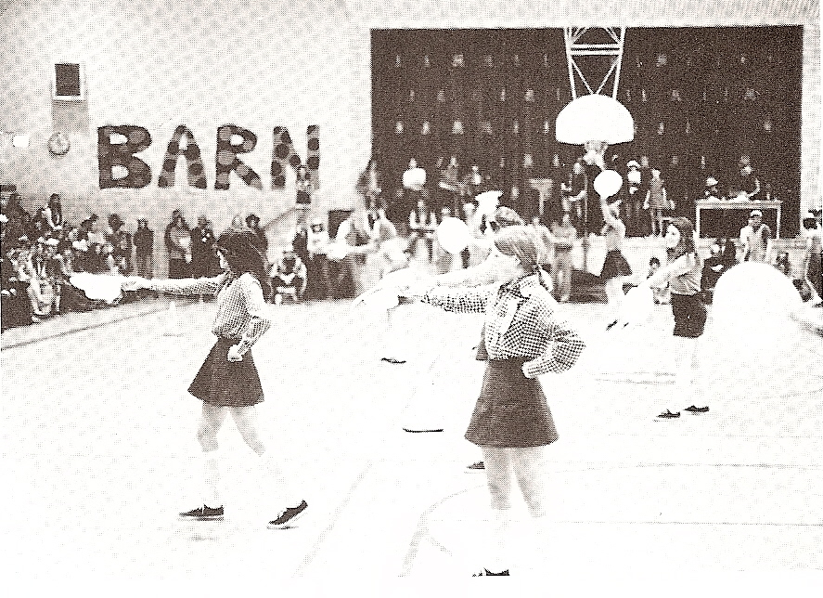

Slide 23
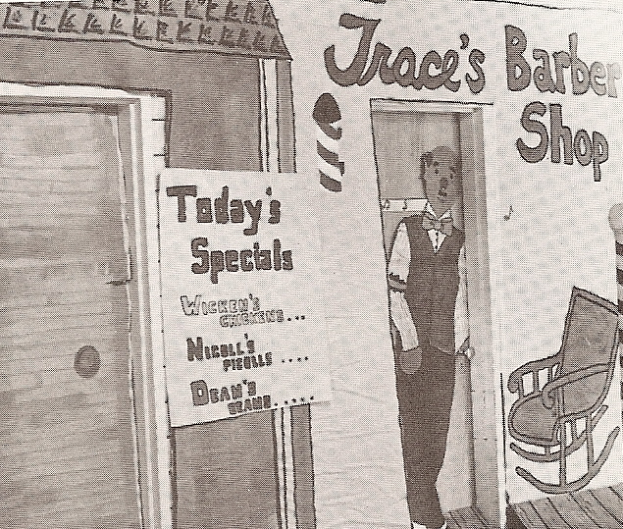

Slide 24
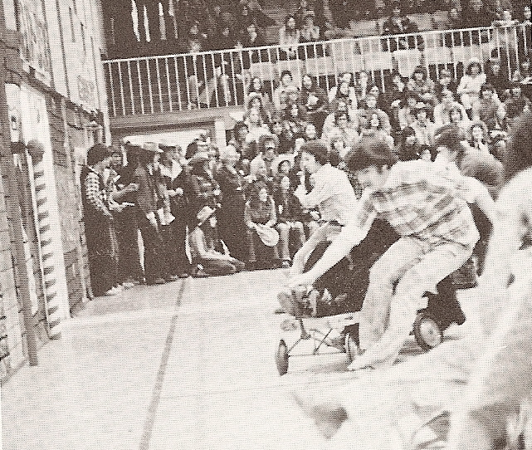
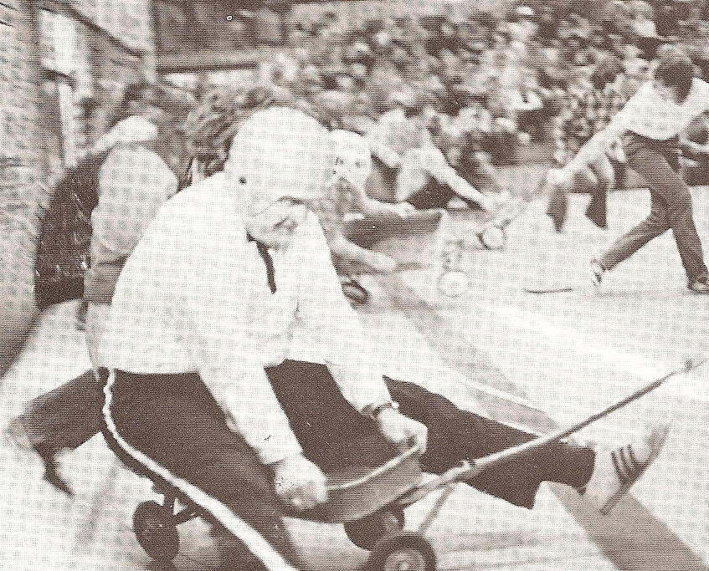
Sure hope my insurance is paid up

Slide 25
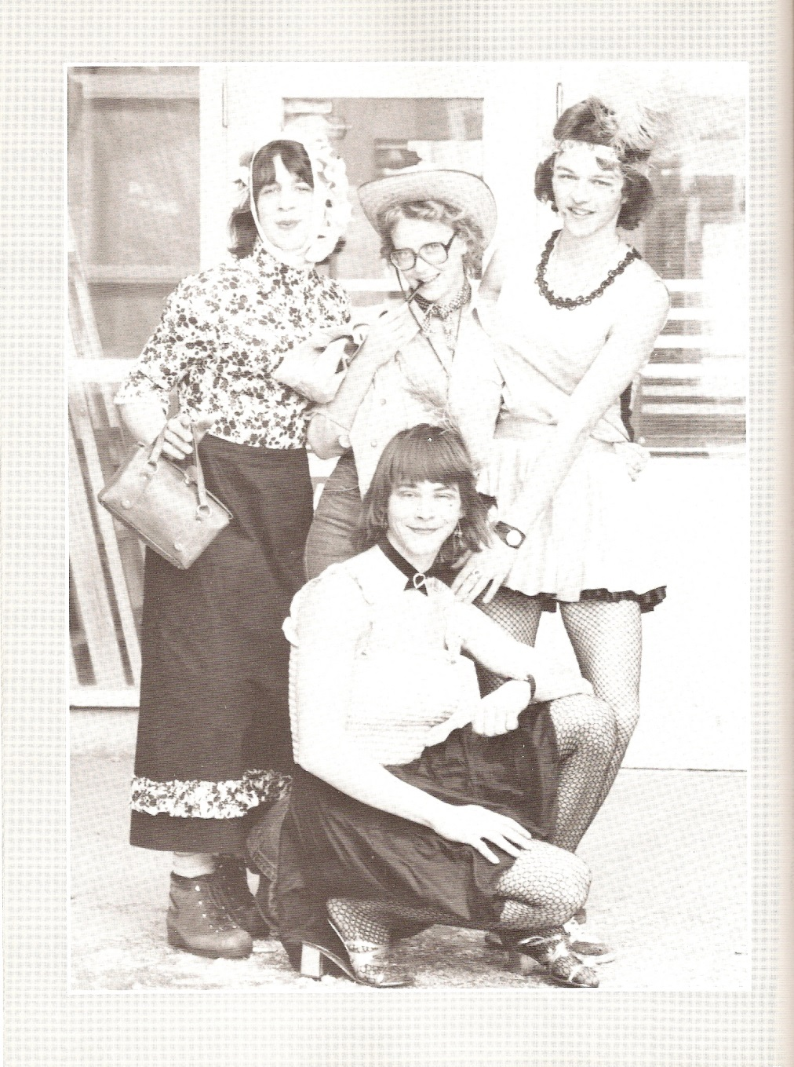
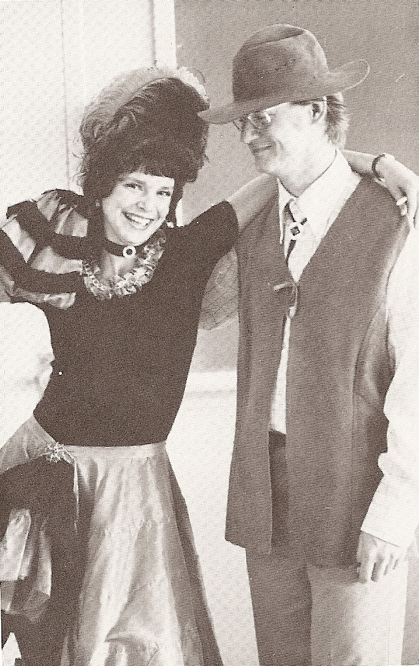

Slide 26
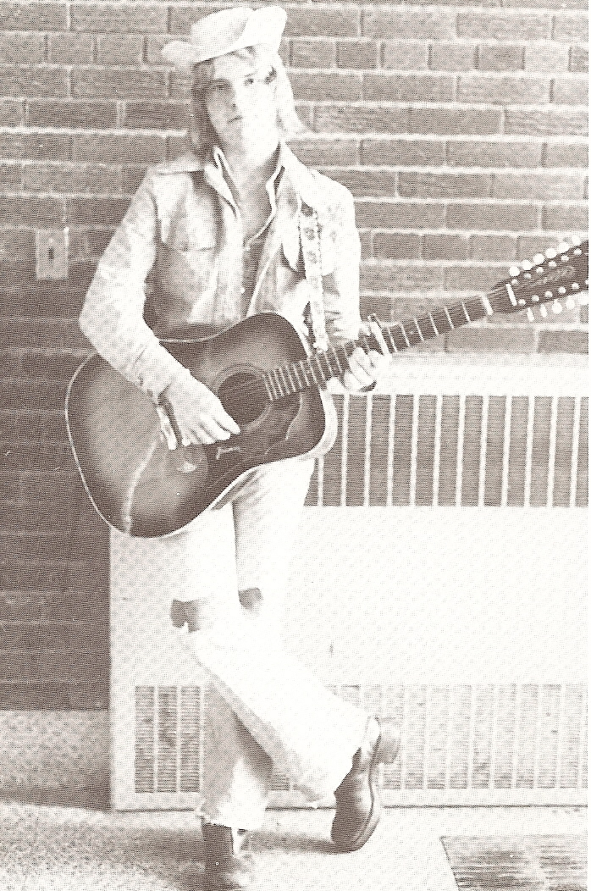
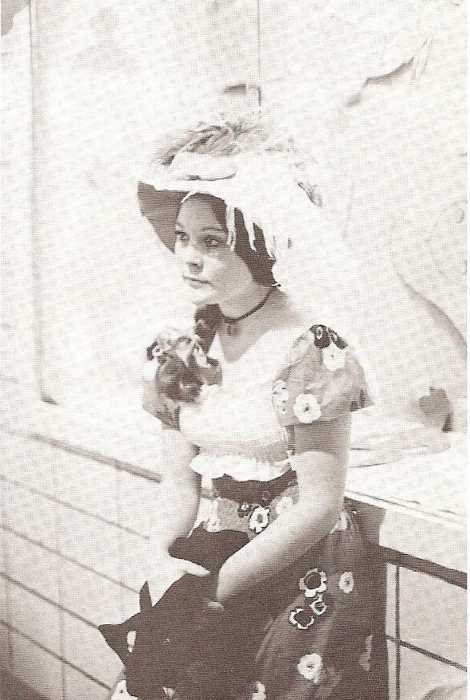

Slide 27
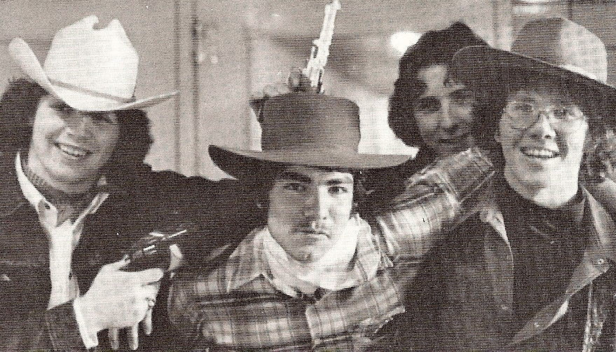

Slide 28
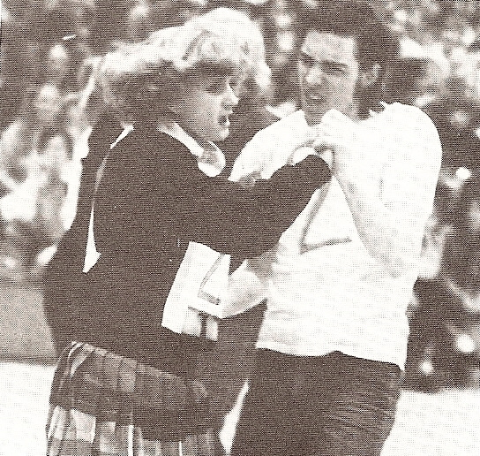

Slide 29
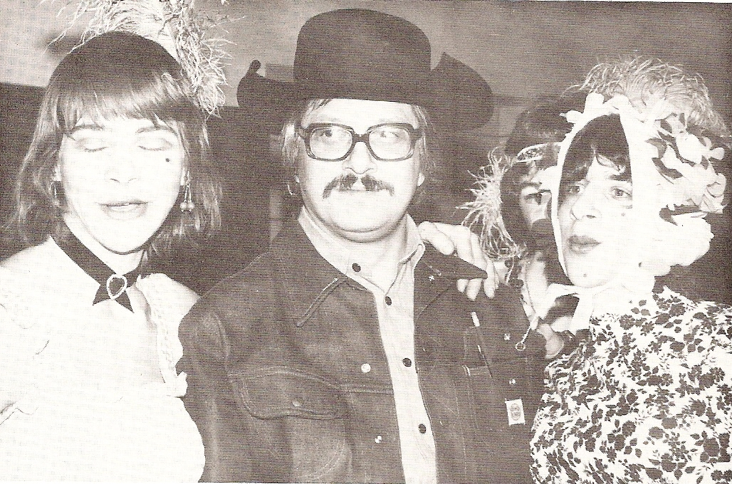

Slide 30
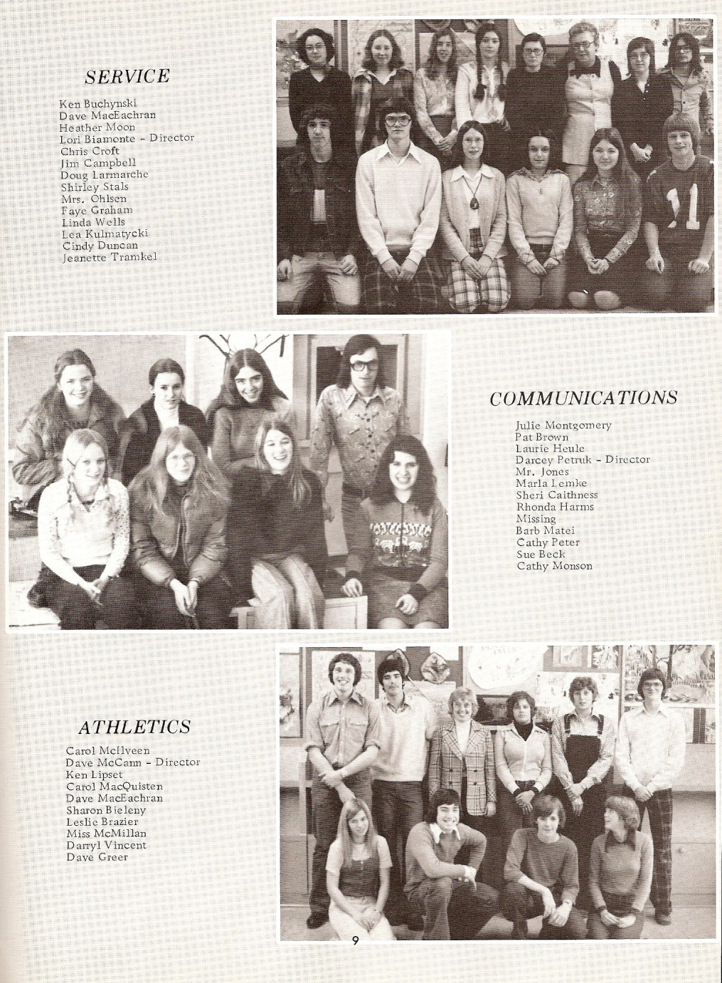

Slide 31
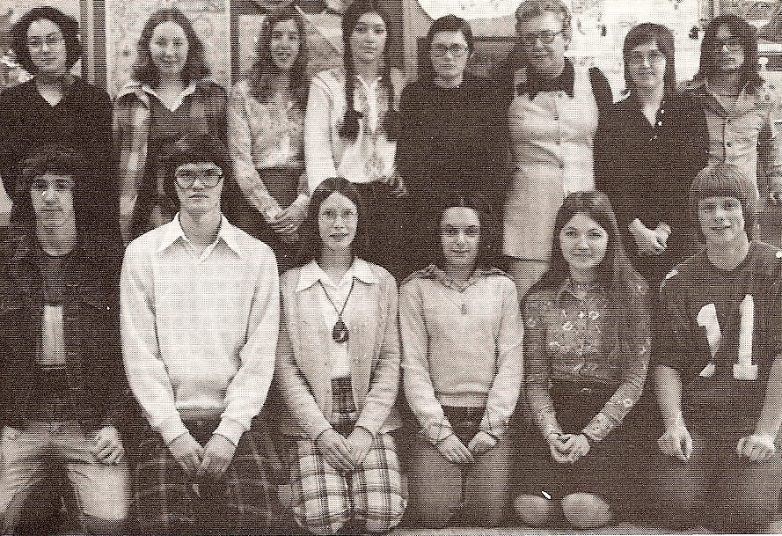

Slide 32
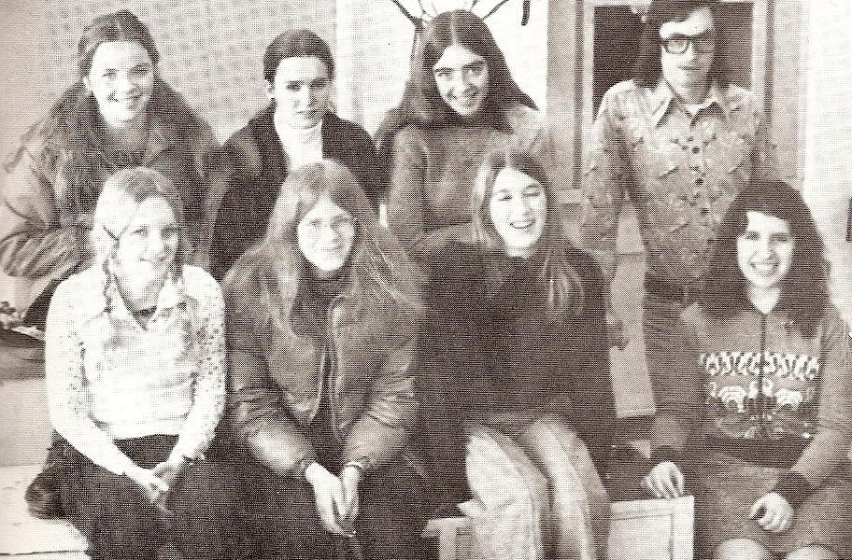

Slide 33
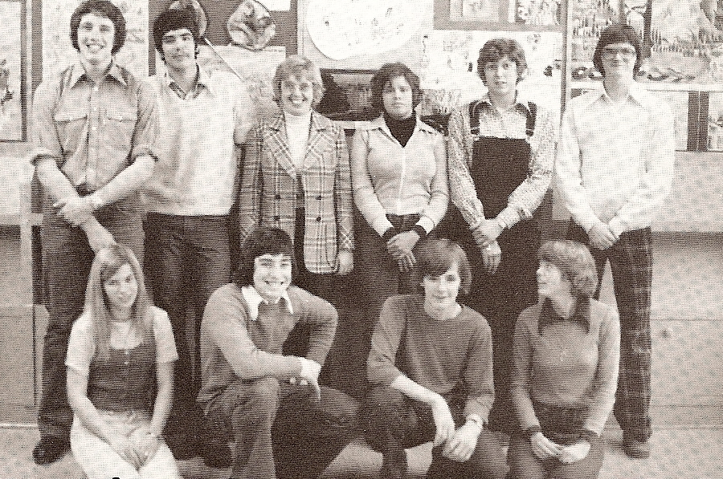
When did those guys get to be so tall?

Slide 34
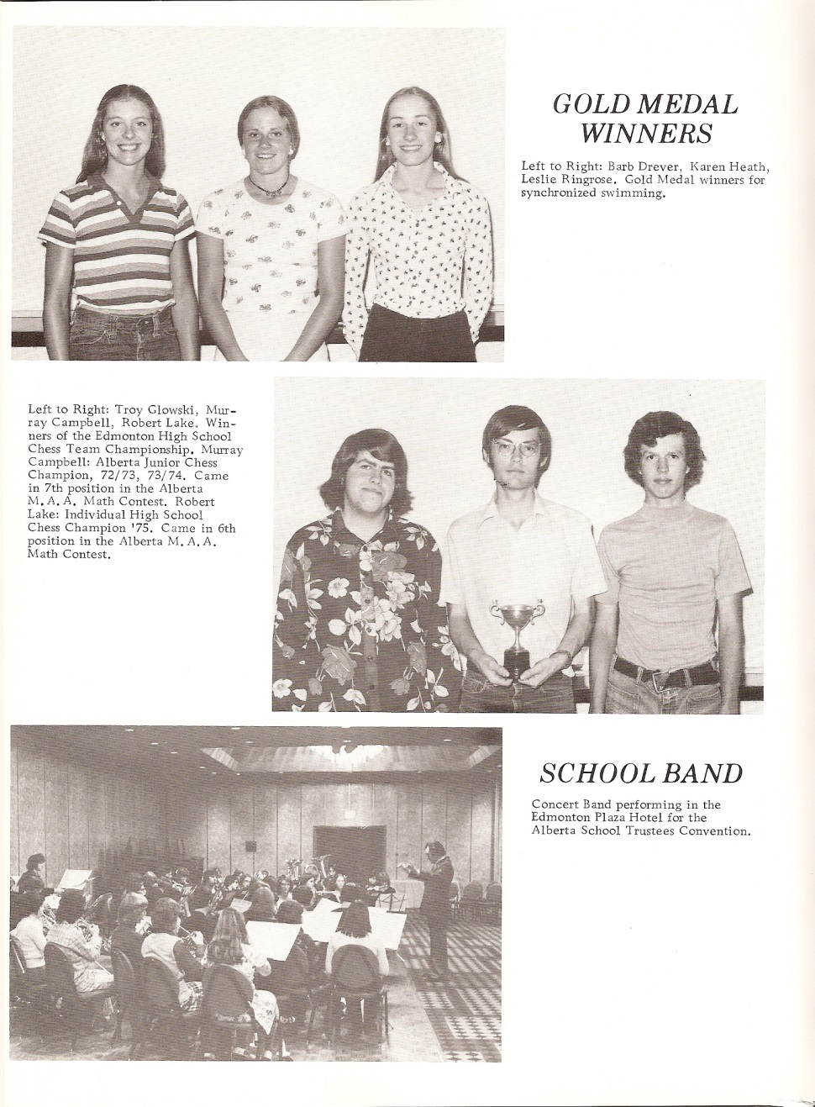

Slide 35
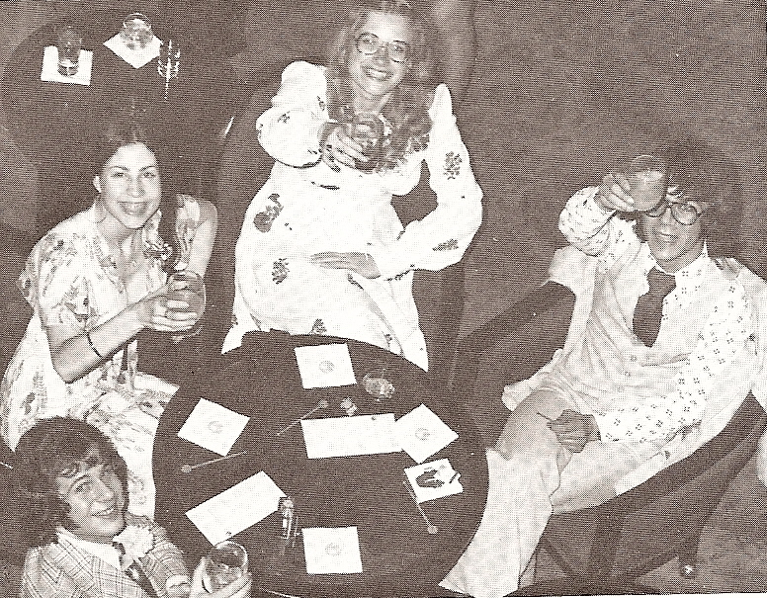
At Graduation

Slide 36
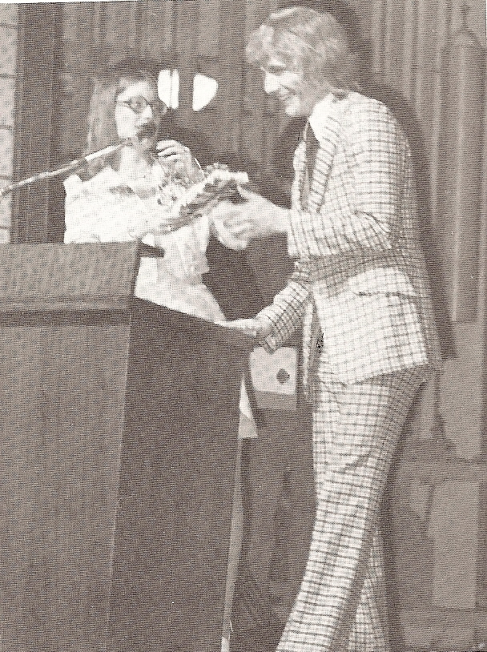
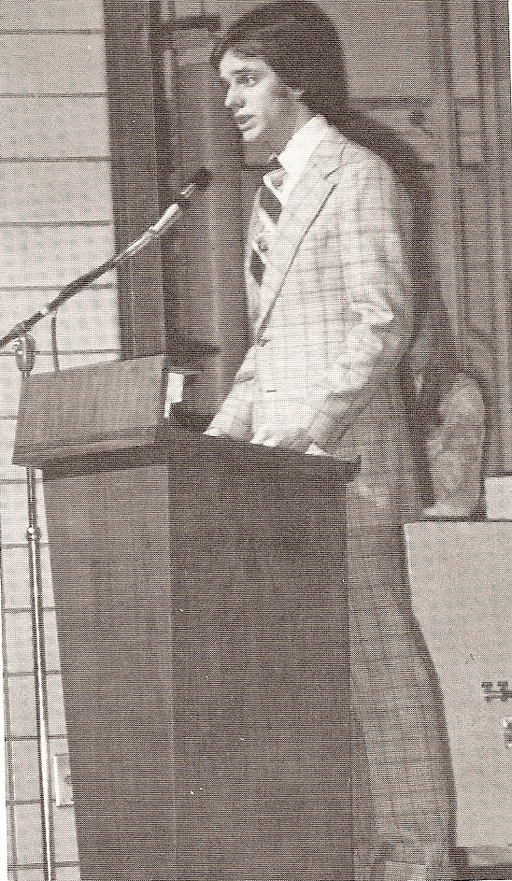
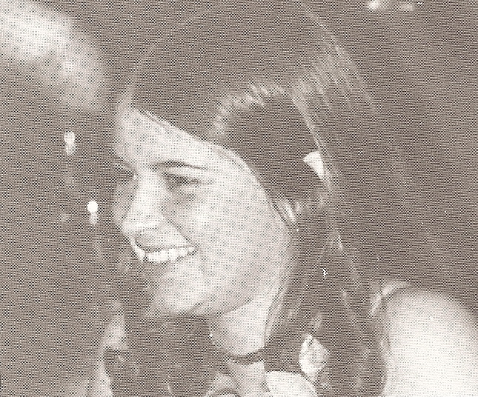

Slide 37

10th Year Reunion
All the photos must have been on invisible paper for this reunion
Class of ‘75
October 1985
Edmonton Inn

Slide 38
Class of ‘75
2000 Reunion
October 7, 2000
Ellerslie Rugby Clubhouse
& RSCHS

Slide 39
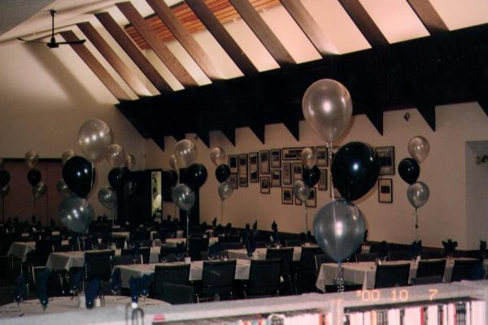
Ellerslie Rugby Club

Slide 40
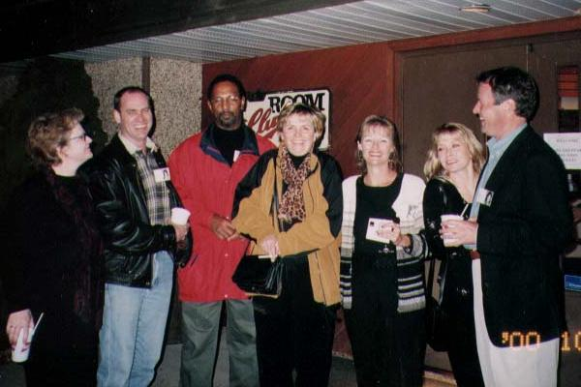

Slide 41
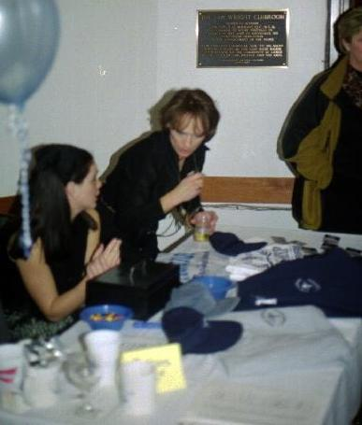
The table of Shep souvenirs with Leslie Ellis and Cindy James
I like that hat

Slide 42
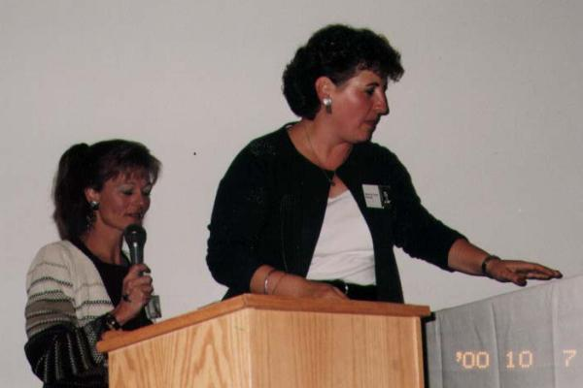
Masters of Ceremonies; Brenda Crooks & Darcey-Lynn Petruk
What song shall I sing?
If you hold your hand like this Earl Bird will land on it

Slide 43
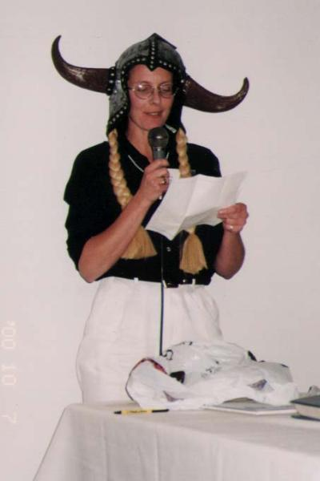
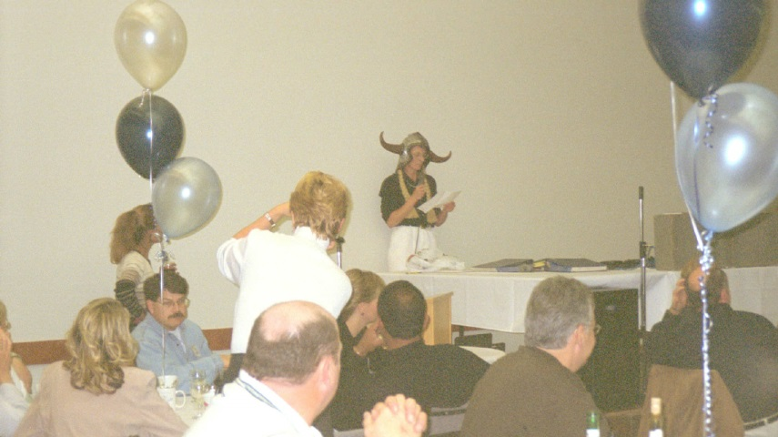
Barb Drever reciting her poem

Slide 44
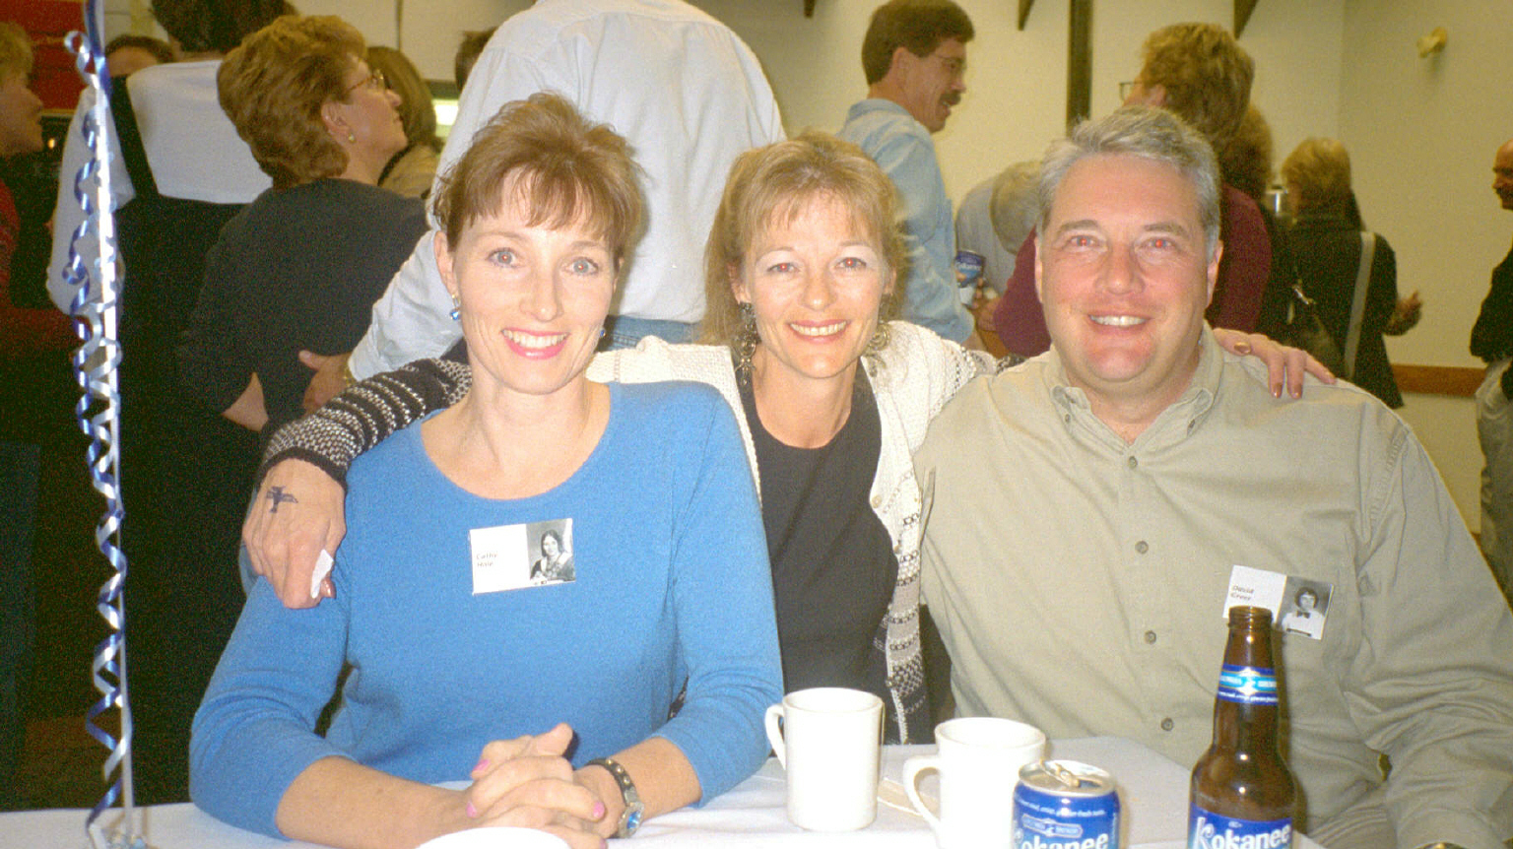
Cathy Hole, Brenda Crooks, David Greer

Slide 45
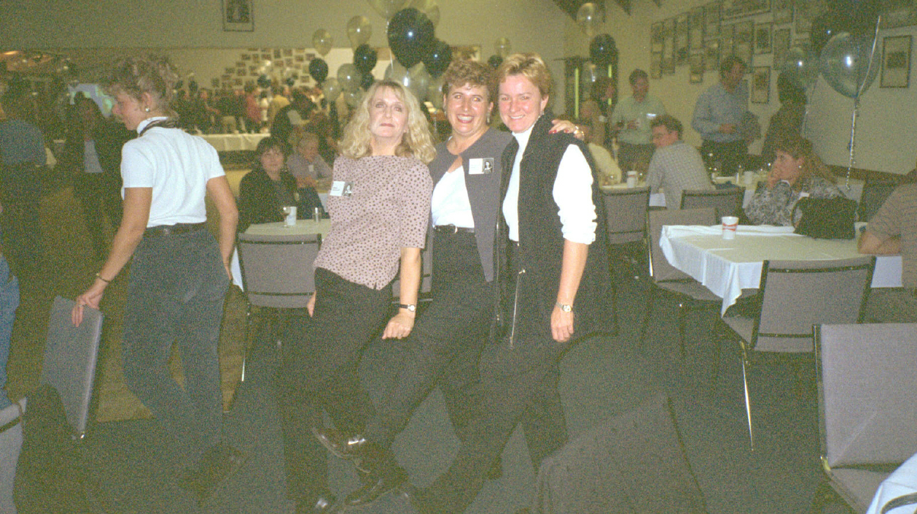
Diane Stockwell, Darcey-Lynn Petruk, Sheri Caithness

Slide 46
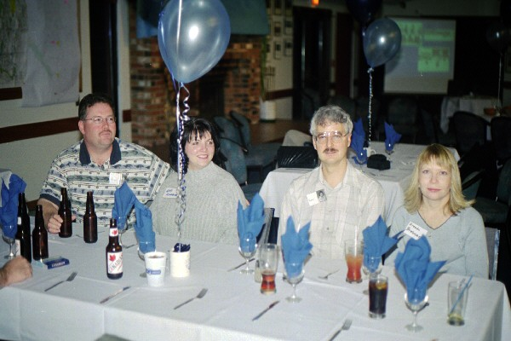
Jeff Homynyk & Lori with Al & Brenda Brebner

Slide 47
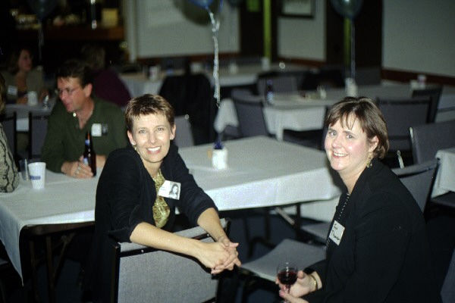
Deb Swenson with Jim Thomson’s wife

Slide 48
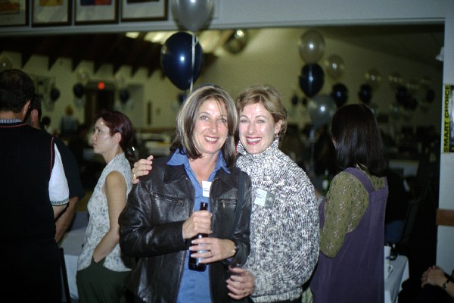
Lauri Runyon and Kelly Runyon

Slide 49
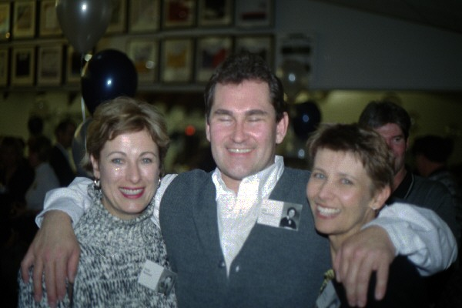
Kelly Runyon, Jim Thomson, Deb Swenson

Slide 50
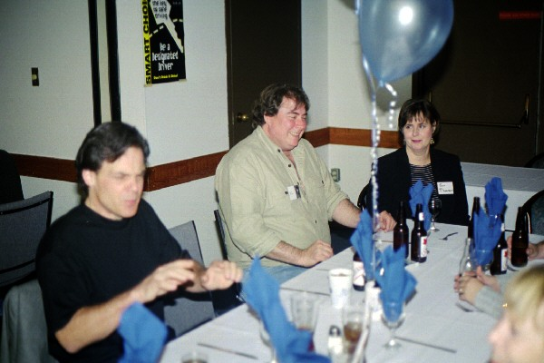
Lyle McIntyre, Glen Glasgow, Jim Thomson’s wife
Lyle that’s a table not a piano

Slide 51
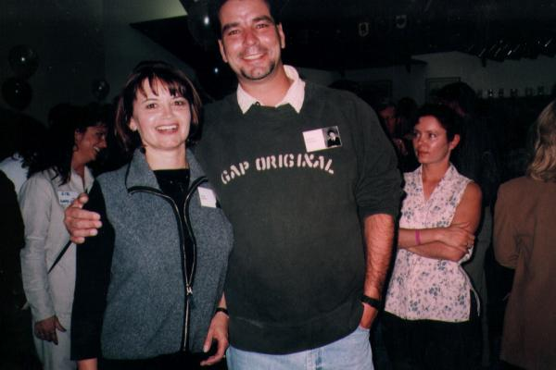
Barb Matei and Darryl Vincent

Slide 52
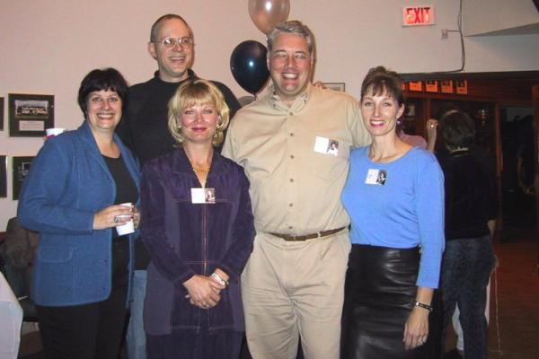
Nancy Hulbert, Glenn Rollans, Cathy Peter, David Greer, Cathy Hole

Slide 53
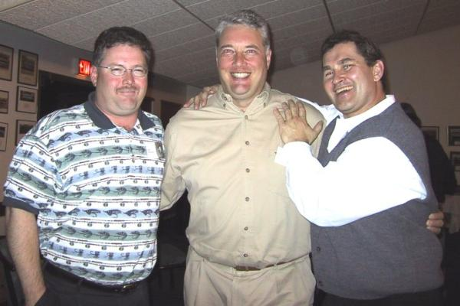
Jeff Homynyk, David Greer, Jim Thomson

Slide 54
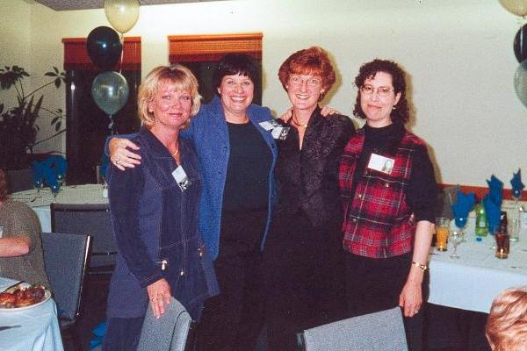
Cathy Peter, Nancy Hulbert, Jennifer Burns, Arlene Aaron

Slide 55

Cathy Peter, Jennifer Burns, Darcey-Lynn Petruk, Joanne Olstad, Guy Huntington, Bev Hawreliak, Marion MacMillian

Slide 56

Jennifer & Barry Burns, Nancy Hulbert, Gordon Maddison, Terry Maddison & his wife, Cathy Peter, Arlene Aaron

Slide 57

Diane Stockwell, Brenda Crooks, Susan Guild, Cathy Hole

Slide 58

Guy Huntington & Barb Matei

Slide 59

Paul Bertles, Kerry Byford, Dave Berry

Slide 60

Bambi Delbarre and Leslie Ellis

Slide 61

Paula Weisbeck, Amigo, Deb Swenson

Slide 62

Susan Guild and Travis Coulter

Slide 63

Guy Matheson & Jim Travis

Slide 64

Jim Thomson & Ralph Godfrey

Slide 65

Sid Edelmann, Rob Henderson, Travis Coulter

Slide 66

Barb Drever, Bambi Delbarre. Shirley Kinash & Dan Starko

Slide 67

David Holm, Stephen Seto, Rob Henderson, Paul Bertles, Daryl Jackson, Lynda Taylor

Slide 68

Jeff Homynyk and Debbie Albrecht

Slide 69

Brenda Crooks & Allan McLean

Slide 70

Sheri Caithness & Rozelle Morton
And then on page 326…

Slide 71

Linda Sjoberg, Bev Hawrelak, Carol MacQuisten

Slide 72

Sheree Lickfold, Barb Matei with Lorna Rydman

Slide 73

Lars Christensen, Travis Coulter, Dale Ward, Keith Jakobsen

Slide 74

Pam Winters

Slide 75


Chris & Jeff Homynyk

Slide 76

Alec MacRae was the DJ…we danced to the music from our era

Slide 77

Chris and Gary Bradbury

Slide 78


Slide 79

Open House at RSCHS
25th Year Reunion
Sunday, October 8, 2000

Slide 80

Greeting people

Slide 81

Brenda Crooks, Bambi Delbarre, Sid Edelmann, Jack Stewart

Slide 82

Wandering the halls at RSCHS with family and friends

Slide 83

Darryl Jackson, David Holm

Slide 84

John & Ben Huckell

Slide 85

Barb Matei, David Granthan, Nancy Hulburt, Sheree Lickfold

Slide 86

Friends reminiscing – Carla, Nancy and Deb

Slide 87

Ruth Spady, Barb Matei, Sheree Lickfold, Pam Winters

Slide 88


Slide 89


Slide 90

2nd floor hallway

Slide 91




Slide 92


Slide 93

Chris Homynyk and Astrid Loff

Slide 94

The 2000 Reunion Organizing Committee Leslie Ellis, Brenda Crooks, Darcey-Lynn Petruk, David McKay, Chris Alloway, Dianne Stockwell

Slide 95

The 2000 Reunion Organizing Committee Ladies

Slide 96


Slide 97
Junior High Groups

Slide 98

Wellington Junior High

Slide 99

Laurier Heights Junior High

Slide 100

Crestwood Junior High

Slide 101

Parkview Junior High

Slide 102

Sherbrooke Junior High

Slide 103

Talmud Torah Junior High

Slide 104

Westminister Junior High

Slide 105

Westmount Junior High

Slide 106


32nd Year Reunion Happy 50th birthday!
October 6, 2007
Mix and Mingle at
Bo’diddley’s Roadhouse

Slide 107
How the heck did we get this old?!!!!!

Slide 108


Slide 109


Slide 110

Greetings by Chris Alloway & Carol MacQuisten

Slide 111

20 questions to catch up with classmates!

Slide 112

I am sure there is something wrong with the math…are we really 50?

Slide 113

The beer seems to still be popular after all these years

Slide 114

Who are you again?

Slide 115

Laurie Jardine, Rob Lake, Lorna Rydman

Slide 116

David Grantham and Barb Drever

Slide 117

Caron Miller, Leslie Ellis, Traci Findlay and Patty Baker

Slide 118

Bev Hawrelak and Linda Sjoberg

Slide 119

Shelly Ellis, Wendy Ruemper, Lois Bagot

Slide 120

Chris Alloway and Carol MacQuisten

Slide 121

Where did he say that keg is buried?
Keith Jakobsen and Lars Christensen

Slide 122

Rob Sokil

Slide 123

Judy Clarkson, Gordon Snow and Gordon Snow's Wife

Slide 124

Cathy Hole, Leslie Ellis and Carol MacQuisten

Slide 125

Chris Alloway, Lorna Mitchell and David Grantham

Slide 126


Slide 127

Linda Sjoberg

Slide 128

David McKay, Laurie Symington, Blaine McGillivray, Janice McGillivray, Leslie Ringrose

Slide 129

David Grantham and Sheree Lickfold

Slide 130

Reunion at Bo’diddley’s Roadhouse

Slide 131



Slide 132

Arlene Aaron, Cathy Peter, Terry Maddison

Slide 133

Terry Maddison, Darcey-Lynn Petruk, Dave MacEachran, Dave McCann, Ron Graham

Slide 134

Cathy Peter, Nancy Hulbert, Jennifer Burns, Arlene Aaron and Cathy Hole

Slide 135

Former Cheerleaders: Barb Matei, Betty Kneller, Lorna Mitchell, Cathy Hole and Bev Hawreliak

Slide 136

Cathy Peter and Cathy Hole

Slide 137
Former Cheerleaders: Barb Matei, Betty Kneller, Lorna Mitchell, Cathy Hole and Bev Hawreliak

Slide 138

Westmount Alumni: Laurie Jardine, Lorna Rydman, Wendy Ruemper,
Lois Bagot, Shelly Ellis, Sheree Lickfold, Rob Lake

Slide 139

Westmount Alumni: Lorna Rydman, Wendy Ruemper, Lois Bagot, Janice McGillivray,
Lars Christensen, Sheree Lickfold, Blaine McGillivray, Shelly Ellis

Slide 140

Lorna Rydman, Mark Abrams, Barb Matei, Rob Lake

Slide 141

Chris Alloway, Darcey-Lynn Petruk, Brenda Crooks, Rob Lake, Carol MacQuisten

Slide 142

Laurier Heights Alumni

Slide 143


Slide 144


Slide 145

Sherbrooke Alumni

Slide 146

Westminster Alumni

Slide 147

Westmount Alumni

Slide 148

The 2007 Reunion Committee: Diane Stockwell, Brenda Crooks, Leslie Ellis,
Darcey-Lynn Petruk, David McKay, Bambi Delbarre, Chris Alloway

Slide 149


Slide 150
.
On Saturday September 27, 2008, Ross Sheppard Composite High School celebrated their 50th anniversary with an afternoon open house at the school followed by an evening celebration at the Northlands Agricom
The Class of 1975 was there to help with the celebration!

Slide 151
RSCHS 50th Anniversary
September 27th 2008
Afternoon Open House at RSCHS

Slide 152

South Wing Hallway

Slide 153

North Wing Hallway

Slide 154

Cafeteria

Slide 155

Cafeteria

Slide 156

2nd Floor Bookloft

Slide 157

Rob Lake, Barb Matei, Sheree Lickfold, Judy Bouwman

Slide 158

Rob Lake, Barb Matei, Parlee Sollway

Slide 159

Barb Matei, Brian White (French Teacher), Rob Lake

Slide 160
Celebration at Northlands Agricom
RSCHS 50th Anniversary
September 27, 2008

Slide 161

Elvis Presley Impersonators (from the Class of 1969?)

Slide 162

Judy Bouwman, Sheree Lickfold, Rob Lake, Barb Matei

Slide 163

Rob Lake and Norman Muir (Math Teacher – 90 years old then!)

Slide 164


Gift to RSCHS for their 50th anniversary from the Class of 1975. We were the only
graduating class to present the school with a gift marking the occasion.

Slide 165

Presenting the gift to RSCHS from the Class of 1975: Guy Matheson, Janice Zinyk,
Rob Lake, Sheree Lickfold, Judy Bouwman, Barb Matei, Alan Querengesser

Slide 166

The Rocking Chair Thunderbird
(concept by Darcey-Lynn Petruk, designed by David Graham and polished production by David Grantham)

Slide 167

Presentation to the school’s Vice-Principal

Slide 168

Janice Zinyk, Rob Lake, Barb Matei, Guy Matheson, Judy Bouwman, Sheree Lickfold

Slide 169

Rob Lake with a David Aaron signature RSCHS photo he won
Judy Bouwman, Barb Matei, Rob Lake, Sheree Lickfold

Slide 170

RSCHS 2015

Slide 171




Slide 172



Large Gymnasium

Slide 173


Small gymnasium

Slide 174



South wing hallway under construction

Slide 175



North wing hallways and lockers with blue paint

Slide 176


Cafeteria

Slide 177

Alumni Room (which is the temporary library)

Slide 178

Gift from the Class of 1975 to RSCHS in 2008 (proudly displayed in the Alumni Room)

Slide 179

Totem Dreamcatcher in the Alumni Room

Slide 180

Bleachers and field at Coronation Park

Slide 181

Coronation Park Curling Rink

Slide 182

Coronation Park Tennis Courts

Slide 183

Peter Hemmingway (formerly Coronation) Pool

Slide 184
Did we see the following when we went to RSCHS in1975?
“The more things change, the more
they will never be the same again”
2015

Slide 185

2015
Wheelchair Ramp

Slide 186

2015
Accessibility Ramp for the Disabled

Slide 187

2015
Scent-Free Classrooms

Slide 188

2015
A Shep Mobile App (downloadable from the App Store)

Slide 189

2015
Computer Lab

Slide 190

2015
Robotics Lab

Slide 191

2015
Classroom for Yoga Instruction

Slide 192

2015
Classroom for Community Learning Skills

Slide 193

2015
Goodbye Chalkboards – Hello Whiteboards (and Smartboards)

Slide 194

2015
Under Construction! (come back in 3 years time for the “new” RSCHS)

Slide 195
50th Year Reunion - 2025
Derrick Golf and Country Club Edmonton and school tour
October 18th, 2025

Slide 196
Ross Sheppard High School - 2025
Highlights of changes at the school

Slide 197


RSHS in 2025
… looks the same? Check out the name!

Slide 198




…take a look inside!

Slide 199



2025

Slide 200



2025

Slide 201



2025

Slide 202



2025

Slide 203


2025

Slide 204



2025

Slide 205


Kitchen
2025

Slide 206


2025

Slide 207
In 2025, “At Shep We Believe In…
RelationSHEP
PartnerSHEP
MentorSHEP
LeaderSHEP
ScholarSHEP
“If better is possible, then good is not enough”

Slide 208
ACADEMICS
Physical Education
English
Math
Sciences
Biology
Chemistry
Physics
General Science
Forensics
Social Studies
IB Program
PE 10, 20, 30
PE Wellness
Cycling Academy
Sports Performance
Sports Medicine
Outdoor Education
Yoga
2025

Slide 209
GLOBAL LANGUAGES
Chinese Language and Culture
French as a Second Language
Spanish Language and Culture
LANGUAGE PROGRAMS
Chinese Bilingual Program
French Immersion Program
2025

Slide 210
Career & Technology Studies
Animation
Applied Graphic Arts
Audio
Cosmetology
Design Studies
Computer Science & Robotics
Entrepreneurship
Esthetics
Fashion Studies
2025

Slide 211
Career & Technology Studies
Film & Media Art
Financial Management
Food Studies
Information Processing
ShepTV
Photography
Web Design
Yearbook
2025

Slide 212
VISUAL ARTS
Art
Drawing
Ceramics
Painting
MUSIC
Concert Band
Jazz Band
Guitar
Choral Music
Rock Band
Drum Line
PERFORMING ARTS
Drama
Technical Theatre
Advanced Acting
Musical Theatre
Improvisational Theatre
2025

Slide 213
In Memoriam
We note the passing of the following alumni:
Chris Alloway
Gordon Barke
David Barry
Warren Boddy
Barb Carefoot
Mary Jo Corcoran
Bill De Vos
Traci Findlay
Ross Hammond
Rhonda Harms
Cathy Hattersley
Laurie Heule
Rod Kirkpatrick
Mike Klein
Lorraine Kolm
Paul Kuss
James Kyle
Ron Leieve
Gordon Maddison
Keith Milner
Paul Ousman
Barry Preece
Ed Shaske
Rob Sokil
Tom Titus
David Wadson
Randy Waschak
Bruce Webster
Lyal Williams
Gordon Wolfe
Lori Zell
Patty Zolf
Although they are gone, memories of them will always be with us

Slide 214


Slide 215

Once a T-Bird
Always a T-Bird
Always Class of ‘75

