Slide 1
How did this get published? Pitfalls in experimental evaluation of computing systems
José Nelson Amaral
University of Alberta
Edmonton, AB, Canada

Slide 2
Thing #1
Evaluate
Aggregation
Thing #2
Learning
Thing #3
Reproducibility
SPEC
Research

Slide 3
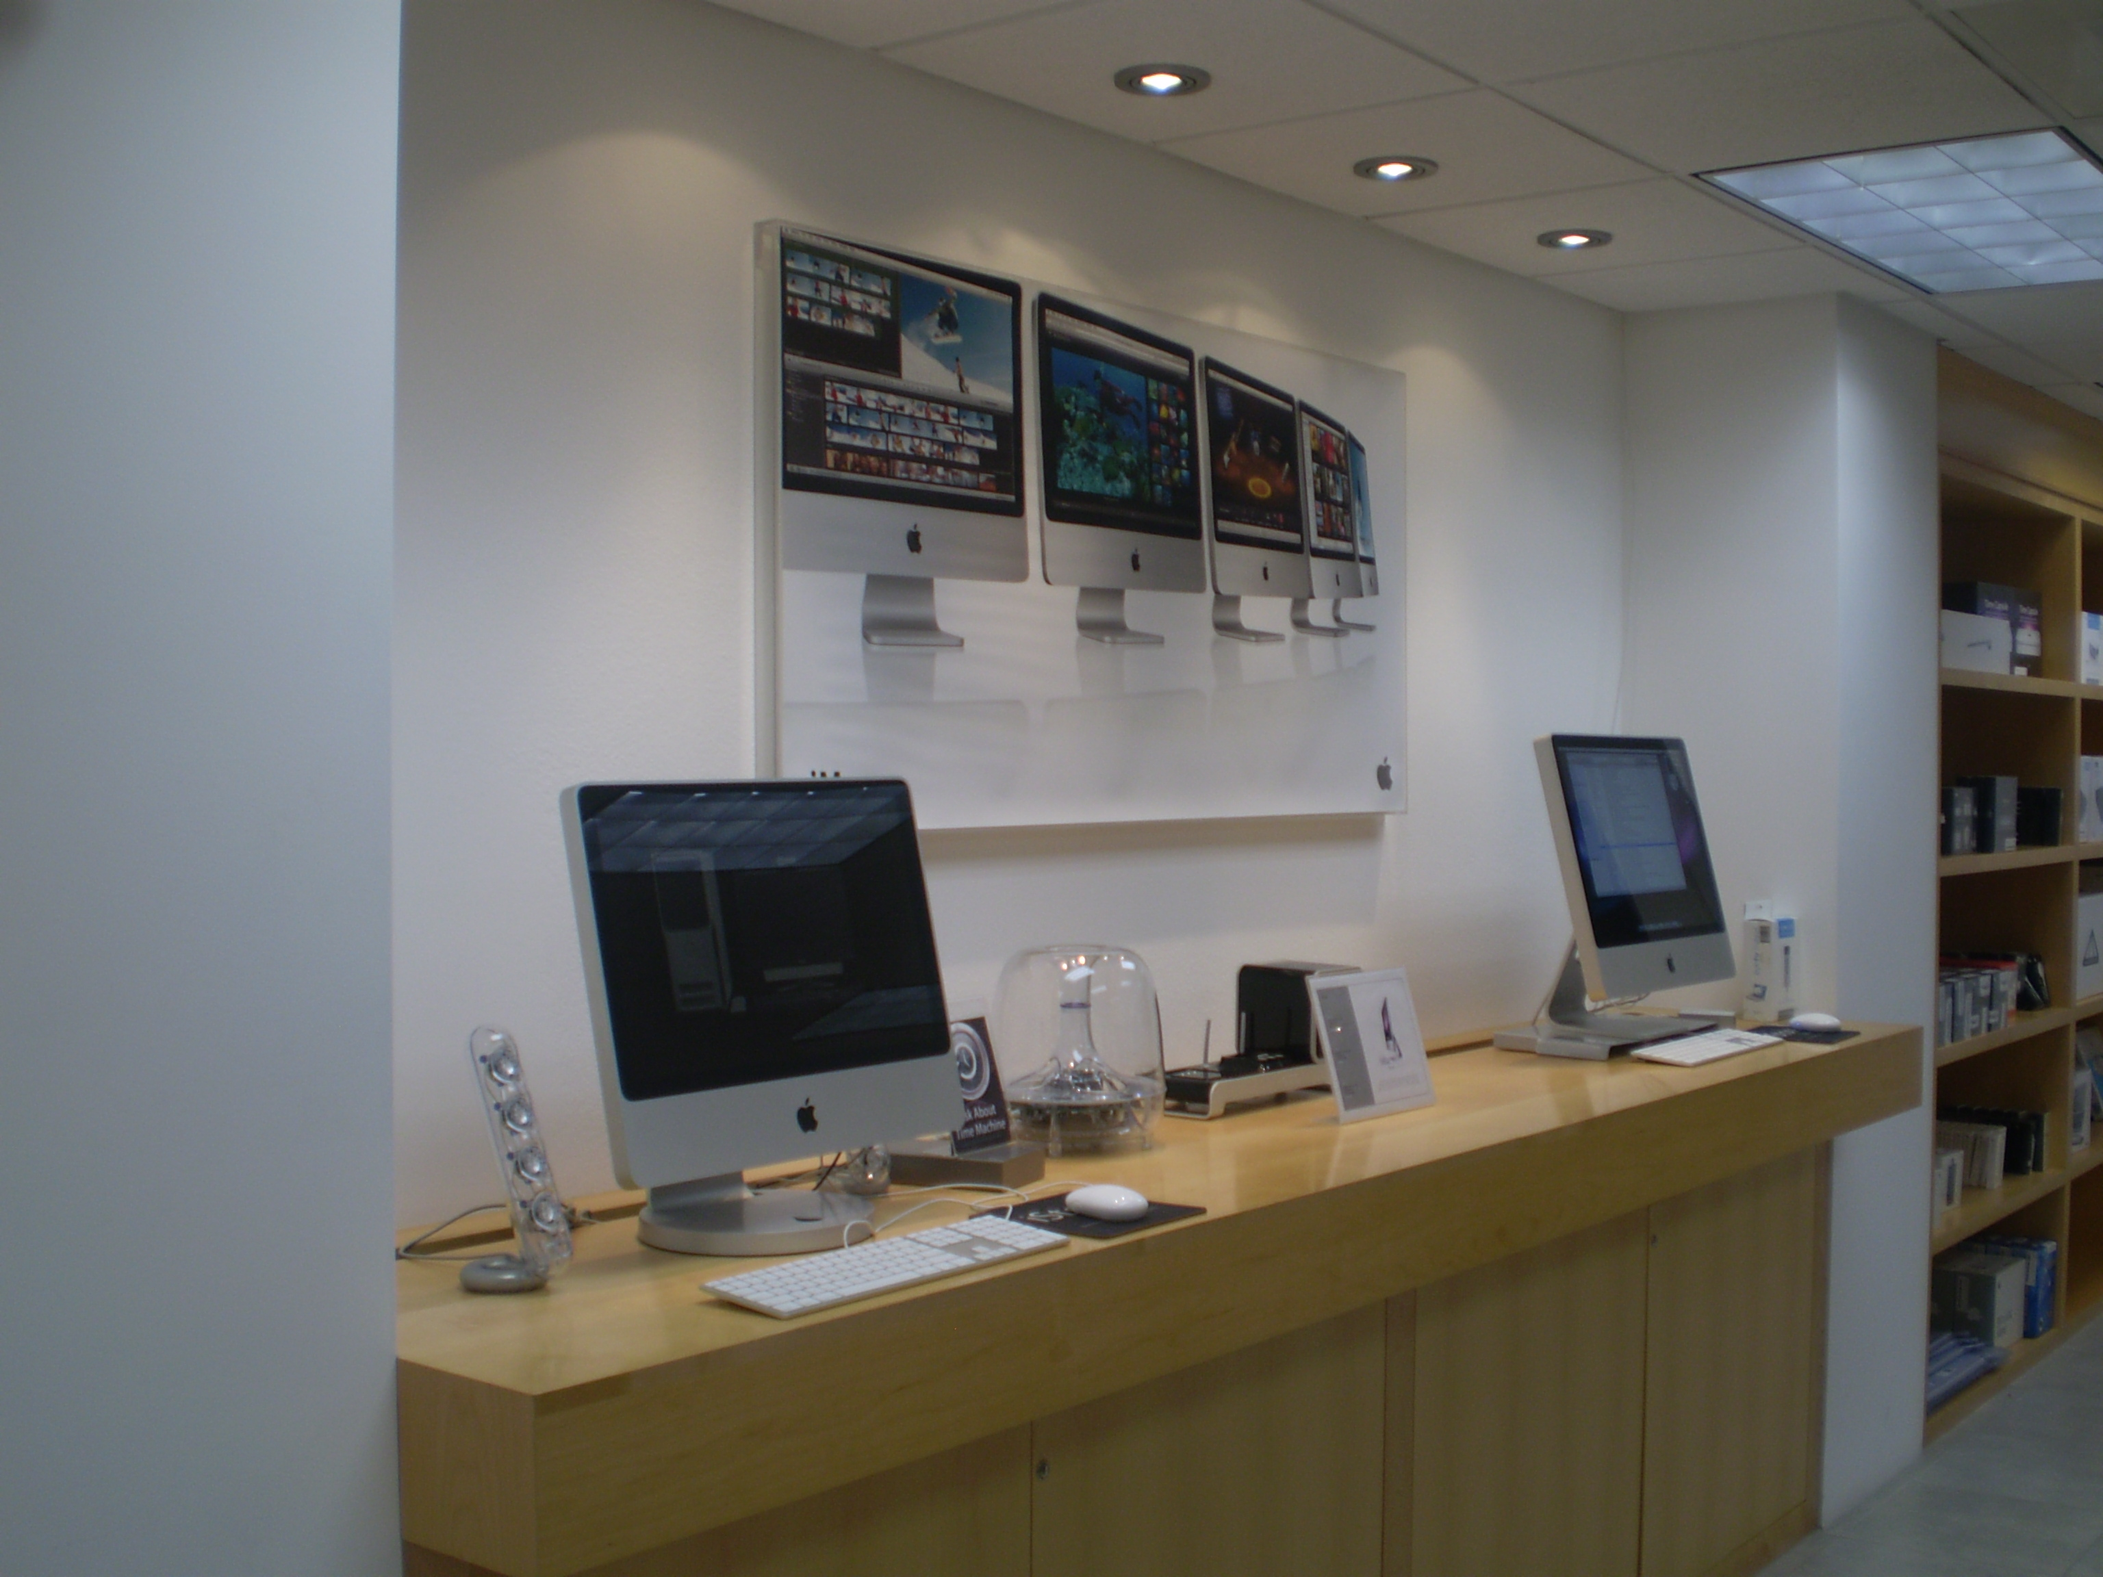
So, a computing scientist entered a Store….
http://archive.constantcontact.com/fs042/1101916237075/archive/1102594461324.html
http://bitchmagazine.org/post/beyond-the-panel-an-interview-with-danielle-corsetto-of-girls-with-slingshots

Slide 4
So, a computing scientist entered a Store….
They want $2,700 for the server and $100 for the iPod.
$ 200.00
$ 3,000.00
I will get both and pay only $2,240
altogether!
http://bitchmagazine.org/post/beyond-the-panel-an-interview-with-danielle-corsetto-of-girls-with-slingshots

Slide 5
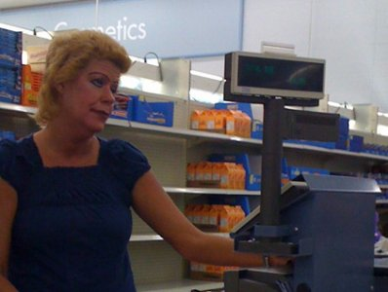
So, a computing scientist entered an Store….
Ma’am you are $560 short.
But the average of
10% and 50% is 30%
and 70% of $3,200
is $2,240.
$ 200.00
$ 3,000.00
http://www.businessinsider.com/10-ways-to-fix-googles-busted-android-app-market-2010-1?op=1
http://bitchmagazine.org/post/beyond-the-panel-an-interview-with-danielle-corsetto-of-girls-with-slingshots

Slide 6
So, a computing scientist entered an Store….
Ma’am you cannot take the arithmetic average of percentages!
But… I just came from at top CS conference in San Jose where they do it!
$ 200.00
$ 3,000.00
http://www.businessinsider.com/10-ways-to-fix-googles-busted-android-app-market-2010-1?op=1
http://bitchmagazine.org/post/beyond-the-panel-an-interview-with-danielle-corsetto-of-girls-with-slingshots

Slide 7
The Problem with Averages

Slide 8
A Hypothetical Experiment
20
10
10
5
4
2
2
1
*With thanks to Iain Ireland

Slide 9
Speedup

Slide 10
Performance Comparison
20
5
5
10
10
2.6
5
4
2
1
benchA
benchD
benchB
0.2
0.2
benchC
The transformed system is, on average, 2.6 times faster
than the baseline!

Slide 11
Normalized Time

Slide 12
Normalized Time
5
5
2.6
0.2
0.2
The transformed system is, on average, 2.6 times slower
than the baseline!

Slide 13
Latency × Throughput
What matters is latency:
Start
Time
What matters is throughput:
Start
Time

Slide 14
Aggregation for Latency: Geometric Mean

Slide 15
Speedup
5
5
2.6
1
0.2
0.2
The performance of the transformed system is,
on average, the same as the baseline!

Slide 16
Normalized Time
5
5
2.6
1.0
0.2
0.2
The performance of the transformed system is,
on average, the same as the baseline!

Slide 17
Aggregation for Throughput
20
10
10
8.25
5
5.25
4
2
2
1
The throughput of the transformed system is,
on average, 1.6 times faster than the baseline.

Slide 18
The Evidence
A careful reader will find the use of arithmetic average to aggregate normalized numbers in many top CS conferences.
Papers that have done that have appeared in:
LCTES 2011
PLDI 2012 (at least two papers)
CGO 2012
A paper where the use of the wrong average changed a negative conclusion into a positive one.
2007 SPEC Workshop
A methodology paper by myself and a student that won the best paper award.

Slide 19
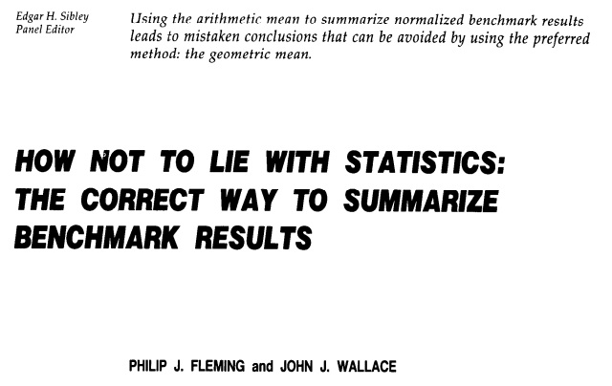
This is not a new observation…
Communications of the ACM, March 1986, pp. 218-221.

Slide 20
No need to dig dusty papers…

Slide 21
So, the computing scientist returns to the Store….
Hello. I am just back from Beijing. Now I know that we should take the geometric average of percentages.
???
$ 200.00
$ 3,000.00
http://www.businessinsider.com/10-ways-to-fix-googles-busted-android-app-market-2010-1?op=1
http://bitchmagazine.org/post/beyond-the-panel-an-interview-with-danielle-corsetto-of-girls-with-slingshots

Slide 22
So, a computing scientist entered a Store….
Thus I should get . = 22.36% discount and pay 0.7764×$3,200 = $2,484.48
Sorry Ma’am, we don’t average percentages…
$ 200.00
$ 3,000.00
http://www.businessinsider.com/10-ways-to-fix-googles-busted-android-app-market-2010-1?op=1
http://bitchmagazine.org/post/beyond-the-panel-an-interview-with-danielle-corsetto-of-girls-with-slingshots

Slide 23
So, a computing scientist entered a Store….
The original price is $ 3,200. You pay
$ 2,700 + $ 100 = $ 2,800.
If you want an aggregate summary,
your discount is 400/3,200 = 12.5%
$ 200.00
$ 3,000.00
http://www.businessinsider.com/10-ways-to-fix-googles-busted-android-app-market-2010-1?op=1
http://bitchmagazine.org/post/beyond-the-panel-an-interview-with-danielle-corsetto-of-girls-with-slingshots

Slide 24
Disregard to methodology when using automated learning
Thing #2
Learning

Slide 25
Example: Evaluation of Feedback Directed Optimization (FDO)

Slide 26
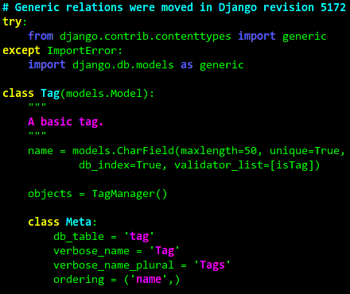
We have:
Application
Inputs
Application
Code
Compiler
http://www.orchardoo.com
We want to measure the
effectiveness of an FDO-based
code transformation.

Slide 27
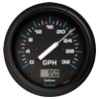
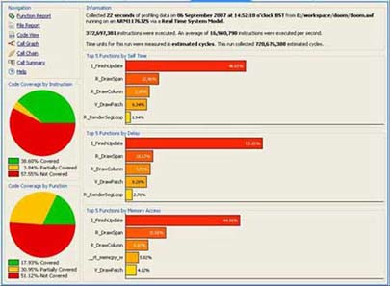
Application
Inputs
Training
Set
-I
Application
Code
Compiler
Instrumented
Code
http://www.orchardoo.com
Profile

Slide 28
Evaluation
Set
-FDO
The FDO transformation produces code that
is XX faster for this application.
Application
Code
Compiler
Optimized
Code
http://www.orchardoo.com
Application
Inputs
Un-evaluated
Set
Profile
Performance

Slide 29
The Evidence
Many papers that use a single input for training and a single input for testing appeared in conferences (notably CGO).
For instance, a paper that uses a single input for training and a single input for testing appears in:
ASPLOS 2004

Slide 30
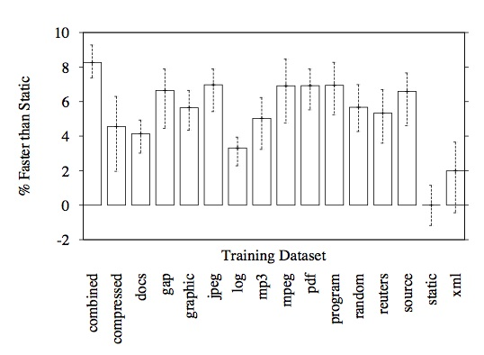
Evaluation
Set
-FDO
Application
Code
Compiler
Optimized
Code
http://www.orchardoo.com
Performance
Performance
Profile
Performance
Performance
Performance

Slide 31
Training
Set
Evaluation
Set
Combined Profiling (Berube, ISPASS12)
Cross-Validated Evaluation (Berube, SPEC07)
-FDO
Application
Code
Compiler
Optimized
Code
http://www.orchardoo.com
Profile
Profile
Profile
Profile
Profile

Slide 32
Evaluation
Set
-FDO
Application
Code
Compiler
Optimized
Code
http://www.orchardoo.com
Wrong Evaluation!
Profile
Performance

Slide 33
The Evidence
For instance, a paper that incorrectly uses the same input for training and testing appeared in:
PLDI 2006

Slide 34
Thing #3
Reproducibility
Expectation:
When reproduced, an experimental evaluation
should produce similar results.

Slide 35
Issues
Thing #3
Reproducibility
Have the measurements been repeated a sufficient
number of time to capture measurement variations?
Availability of code, data, and precise description
of experimental setup.
Lack of incentives for reproducibility studies.

Slide 36
Progress
Thing #3
Reproducibility
Program committees/reviewers starting to ask
questions about reproducibility.
Steps toward infrastructure to facilitate reproducibility.

Slide 37
SPEC Research Group
http://research.spec.org/
14 industrial organizations
SPEC
Research
20 universities or research institutes

Slide 38
SPEC Research Group
http://research.spec.org/
SPEC
Research
Performance Evaluation
Benchmarks for New Areas
Performance Evaluation Tools
Evaluation Methodology
Repository for Reproducibility
http://icpe2013.ipd.kit.edu/

Slide 39
Evaluate Collaboratory:
http://evaluate.inf.usi.ch/
Evaluate
Open Letter to PC Chairs
Anti Patterns
Evaluation in CS education

Slide 40
Parting Thoughts….
Creating a culture that enables full reproducibility seems daunting…
Initially we could aim for:
Reasonable expectation by a reasonable reader that,
if reproduced, the experimental
evaluation would produce similar results.

